Slide 1
Retail Sales Analysis with Python : Walmart Case Study
Exploring The Impact of Temperature, Holidays and Economic Factor on Weekly Sales
Aditi Shah

Slide 2
Business Problem :
Retail businesses experience fluctuations in weekly sales due to multiple external factors.
This project analyzes Walmart sales data using Python to identify how temperature, holidays, CPI, unemployment, and fuel prices influence weekly sales patterns.

Slide 3
Dataset Overview

Slide 4
Variables | Description
Weekly Sales | Total Weekly Revenue ($)
CPI | Consumer Price Index
Temperature | Store Temperature (°F)
Fuel Price | Fuel cost trend ($)
Unemployment | Economic indicator (%)
Holiday Flag | Holiday week or non-holiday
• Walmart retail sales dataset
• 45 stores included
• Data from Feb 2010 – Oct 2012
• Weekly-level sales records

Slide 5
Challenges Faced
• Missing months in yearly data
• Difficult to compare years directly
• No store location information available
• Multiple factors affected weekly sales simultaneously
• Correlation did not always indicate clear causation

Slide 6
Holiday Impact Analysis

Slide 7
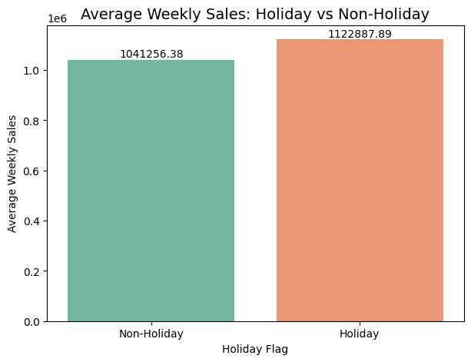
Key Findings:
• Holiday weeks generated higher weekly sales.
• Average sales increased during holiday periods.
• Customer spending activity was stronger during holidays.
• Holiday impact remained visible across multiple stores.
Conclusion:
Holiday periods positively influenced Walmart weekly sales performance.

Slide 8
Temperature Impact Analysis

Slide 9
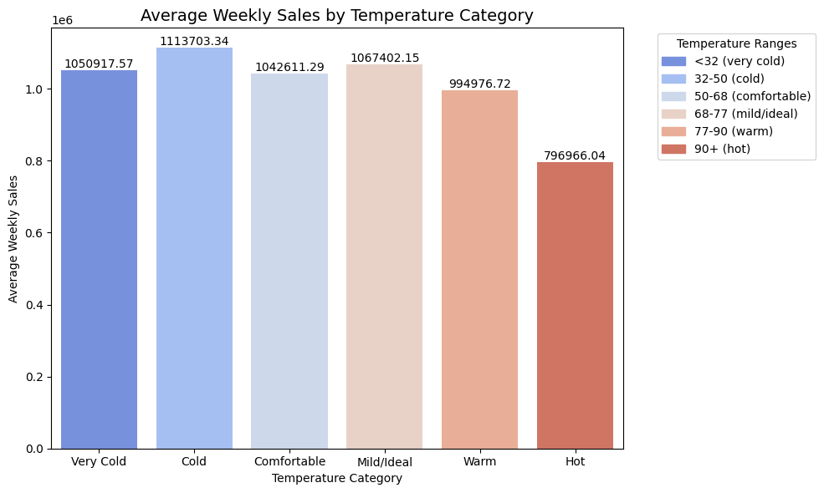
Competitive Advantages

Slide 10
Key Findings:
• Sales remained strongest during cold and ideal temperature ranges.
• Temperatures above 77°F showed noticeable sales decline.
• Extremely hot conditions (90°F+) generated the lowest weekly sales.
• Bottom-performing stores experienced high-temperature conditions more frequently.
• Temperature patterns appeared more influential than holiday frequency alone.
Business Insight:
“Customer shopping activity decreases during extreme heat conditions.”
Conclusion:
Temperature was identified as one of the major factors influencing Walmart weekly sales fluctuations.

Slide 11
Temperature + Holiday Impact analysis

Slide 12
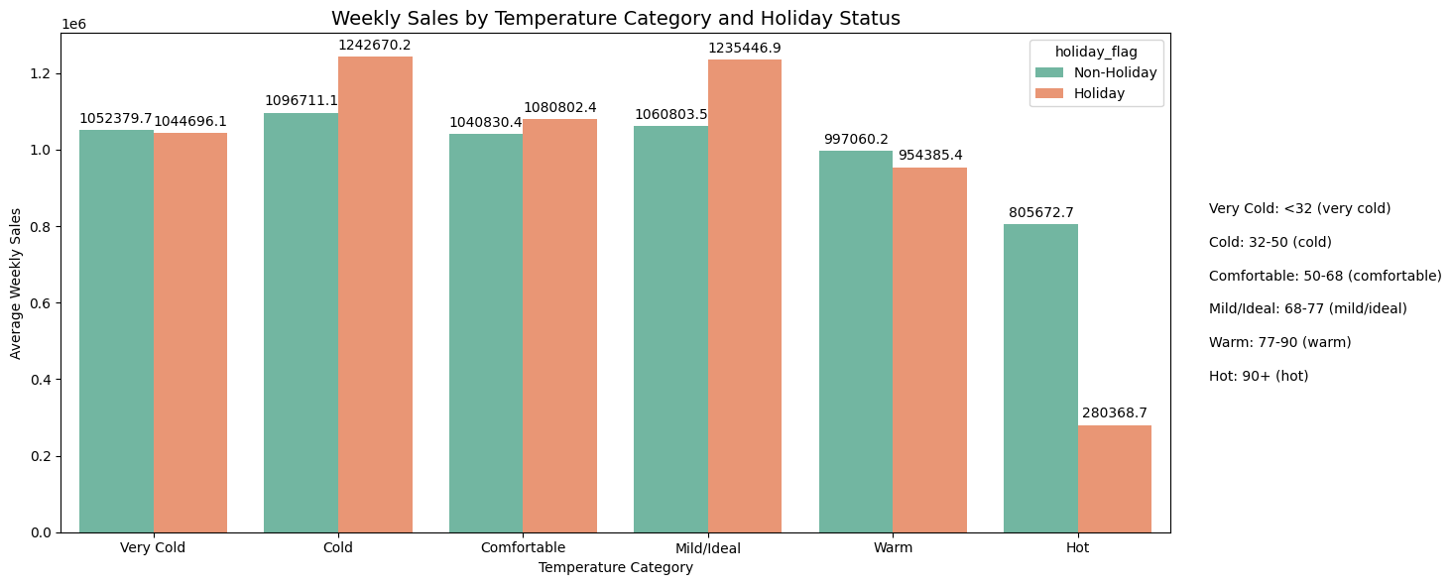

Slide 13
Key Findings
• Holiday sales remained highest during cold and mild/ideal temperature ranges.
• Even during holiday weeks, extremely hot temperatures (90°F+) caused major sales decline.
• Cold holiday periods generated stronger customer shopping activity compared to warm conditions.
•Temperature influenced sales performance alongside holiday events.
• Stores experiencing frequent high-temperature weeks showed comparatively weaker sales performance.
Business Insight
“Holiday demand alone does not guarantee high sales. Weather conditions significantly affect customer shopping behavior and store performance.”
Conclusion
The combined analysis of holiday periods and temperature ranges showed that Walmart weekly sales perform best during holidays with favorable weather conditions, while extreme heat reduces customer purchasing activity even during festive periods.
\\\\\\\\\\\\\\

Slide 14
No. Of Holidays as per Temperature
Temperature | Non-Holiday weeks | Holiday weeks
Very cold (>32°F) | 202 | 38
Cold (32-50°F) | 493 | 71
Comfortable (50-68°F) | 631 | 35
Ideal (68-77°F) | 403 | 18
Warm (77-90°F) | 344 | 17
Hot (90°F<) | 87 | 1
*using year 2011, the only year with complete monthly coverage

Slide 15
Unemployment Impact analysis

Slide 16
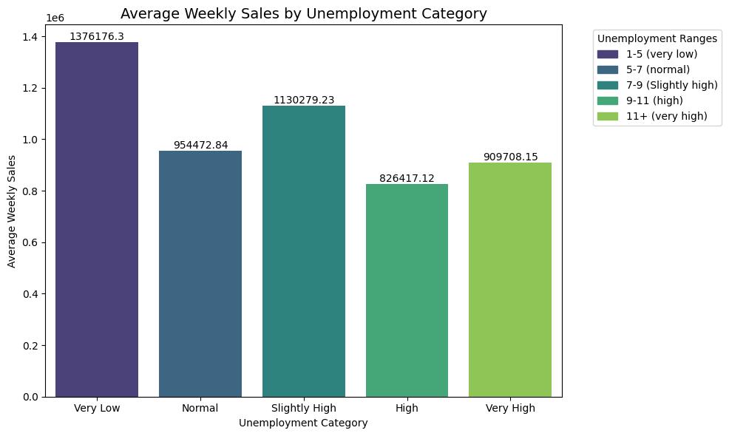

Slide 17
Key Findings
• Stores recorded the highest weekly sales during very low unemployment periods (1–5%).
• Sales performance gradually weakened as unemployment levels increased.
• Holiday weeks consistently produced higher sales than non-holiday weeks across all unemployment ranges.
• Moderate unemployment ranges still maintained stable sales performance, indicating continued customer demand.
• Extremely high unemployment levels showed reduced consumer spending activity.
Business Insight
“Customer purchasing power and employment conditions directly influence retail sales performance, especially during non-holiday periods.”
Conclusion
The analysis suggests that unemployment levels affect Walmart weekly sales by influencing customer spending capacity. Lower unemployment generally supported stronger sales performance, while higher unemployment was associated with weaker weekly sales.

Slide 18
Top 5 vs Bottom 5 Analysis

Slide 19
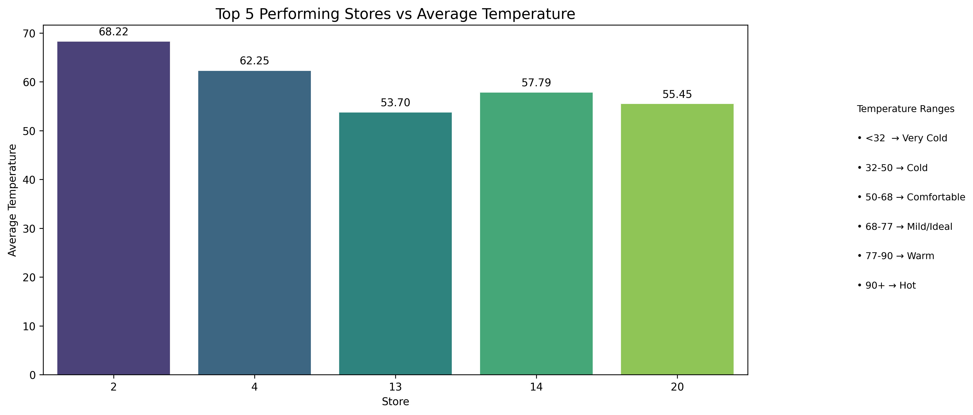

Slide 20
Key Findings
• Top-performing stores experienced favorable temperature conditions more frequently.
• Moderate and ideal temperature ranges aligned with stronger weekly sales performance.
• Extremely high-temperature weeks occurred less often among top-performing stores.
• Holiday periods further strengthened sales performance under suitable weather conditions.
• Sales patterns suggested stable customer shopping activity during comfortable temperatures.

Slide 21
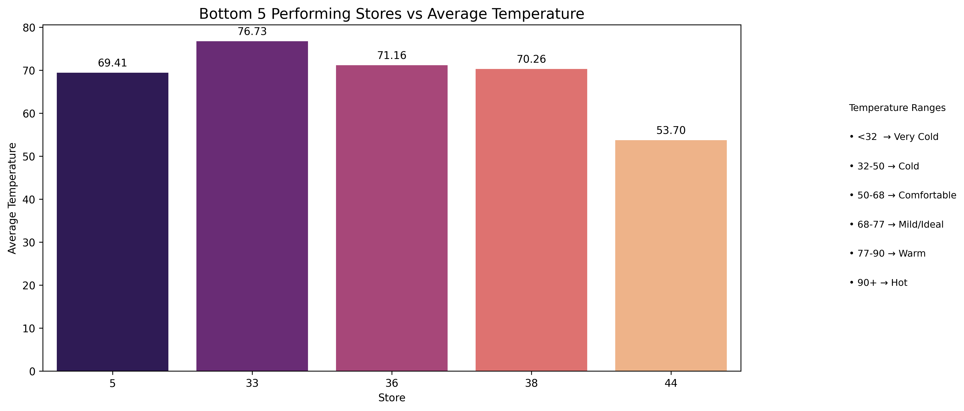

Slide 22
Key Findings
• Bottom-performing stores experienced high-temperature weeks more frequently.
• Extremely hot conditions were associated with comparatively weaker weekly sales.
• Holiday frequency remained similar to top-performing stores.
• Temperature conditions appeared less favorable for consistent customer shopping activity.
• Sales performance showed greater fluctuation during warmer periods.
Combined Conclusion
The comparison between top and bottom performing stores suggested that temperature exposure played a stronger role in sales performance differences than holiday occurrence alone. Stores experiencing more favorable temperature conditions generally maintained stronger and more stable weekly sales patterns.

Slide 23
Q&A(Key Insights)

Slide 24
Q1. What caused higher weekly sales?
Temperature and holiday weeks were the main drivers of higher sales.
Q2. Did other variables affect sales significantly?
CPI, fuel price, and unemployment showed only minor changes in sales.
Q3. Why did Comfortable temperatures not outperform Cold temperatures despite having more holiday weeks?
Higher unemployment during Comfortable temperatures likely reduced customer spending.

Slide 25
Q4. Does temperature affect sales independently of holidays?
A. Yes. Ideal temperatures generated the highest sales even without havingthe most holiday weeks.
Q5. What is the overall conclusion?
A. Weekly sales were driven primarily by temperature and holiday timing. Also slightly by unemployment too.

Slide 26
Business Recommendations

Slide 27
Increase inventory before holiday weeks to meet higher customer demand.
Launch promotions and marketing campaigns during favorable weather conditions.
Schedule additional staff during holidays and favorable weather conditions.
Use temperature and holiday timing as key inputs in sales forecasting.
Monitor economic indicators such as unemployment as supporting factors.

Slide 28
Conclusion

Slide 29
This project explored how environmental and economic factors influence Walmart weekly sales using Python-based analysis and visualization techniques.
The analysis showed that holidays, temperature conditions, and economic variables contributed to sales fluctuations across stores.

Slide 30
Python Workflow
Python was used for:
• Data cleaning
• Grouping and categorization
• Comparative analysis
• Data visualization
• Correlation analysis
Multiple analytical approaches were tested to identify meaningful patterns in sales fluctuations.

Slide 31
Thank You

